Slide 1

Happiness Index Report
Name: Carla Bradley
Course: Data Exploration and Analysis
Professor: Matthew Metzger

Slide 2
Problem Statement
Millions of citizens around the world have lost their jobs. They have watched helplessly as their savings dwindled, as they were confined to their homes—prohibited from interacting with friends, attending church, temple, or music, and even sporting events due to restrictions enacted in response to the COVID-19 pandemic. These situations have incremented the statistics and indices related to depression and suicide.
My project is to identify the societal factors that the government will need to focus on for bringing society together to produce a sense of relief and happiness.
Happiness Index is a valuable resource for determining the societal factors that influenced a country's happiness index before and after the COVID-19 pandemic.

Slide 3
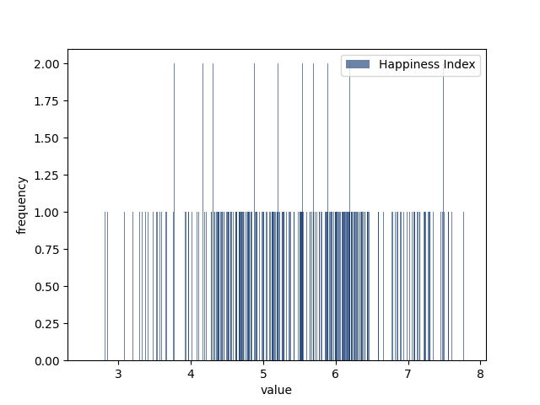
Happiness Index Histogram
The happiness index mean is 5.4, and the median is 5.5; both being very close to each other.
The data appears to be symmetrical distributional with variance value is 1.23

Slide 4
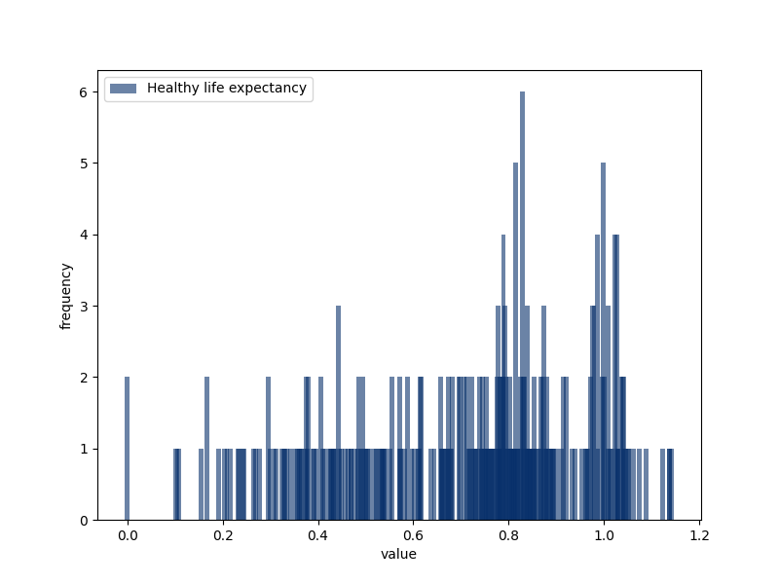
Healthy Life Expectancy Histogram
The Healthy Life expectancy index mean is 0.711, and the median is 0.777.
The data appears to be skewed to the left distributional and variance value is 0.061

Slide 5
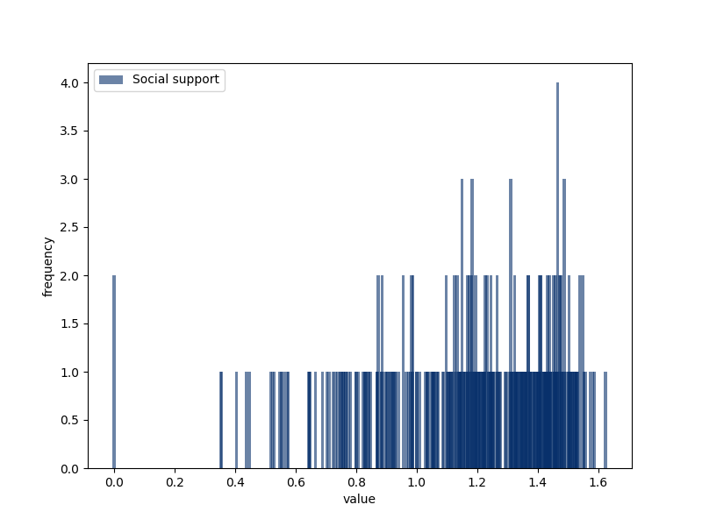
Social Support Histogram
The Social Support index mean is 1.185, and the median is 1.237.
The data appear to be skewed to the left with a variance value is 0.084

Slide 6
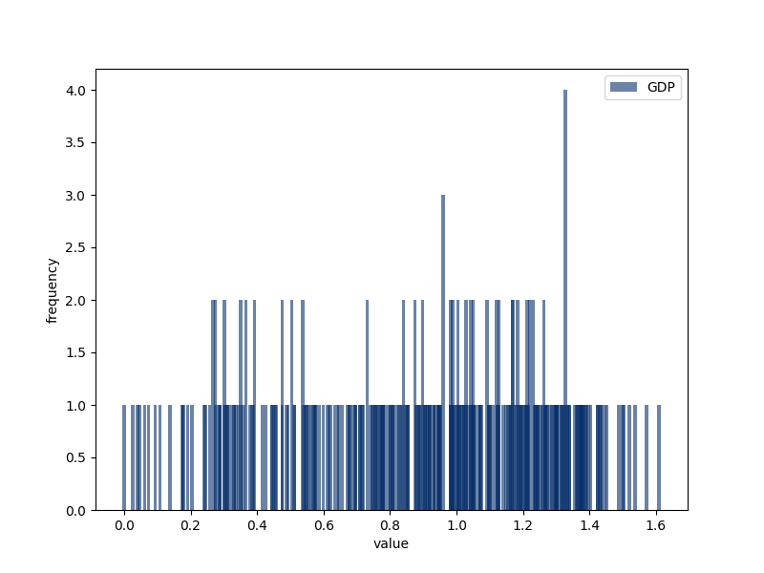
GDP Histogram
The GDP index mean is 0.9, and the median is 0.94.
Data appears to be skewed to the left with a variance value is 0.145

Slide 7
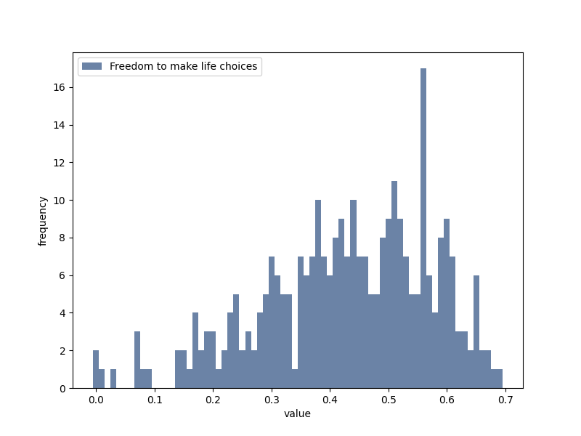
Histogram Freedom to Make Life Choices
Freedom to make life choices index mean is 0.429, and the median is 0.440.
Based on the graph, data appears to be skewed to the left distributional and variance value is 0.021

Slide 8
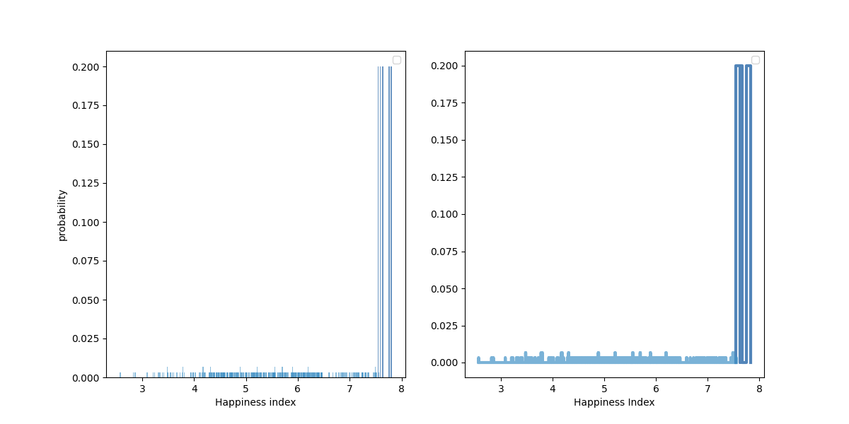
Histogram Equalization: PMF
Based on this histogram, in 2020 the top five happiness index countries are as less likely to get to seven or eight happiness index as the rest of the countries

Slide 9
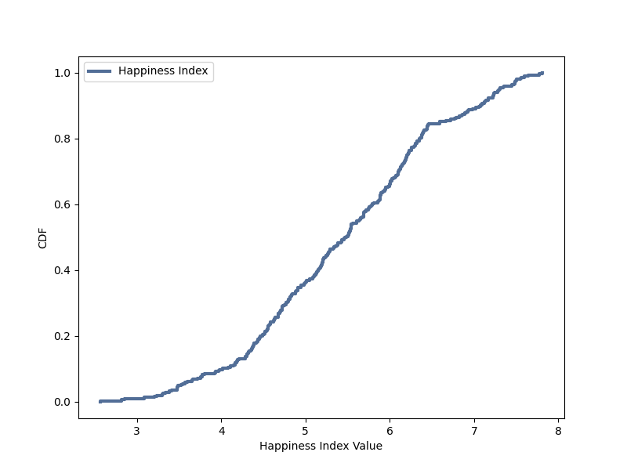
Cumulative Distribution Function (CDF)
Based on the graph, it is observes that 10 percent of the countries will not get above 4.0 on the Happiness Index and 90 percent of the countries will get a happiness index from 4.5 to 8 points.
Note: 10 being the highest number on the happiness index.

Slide 10
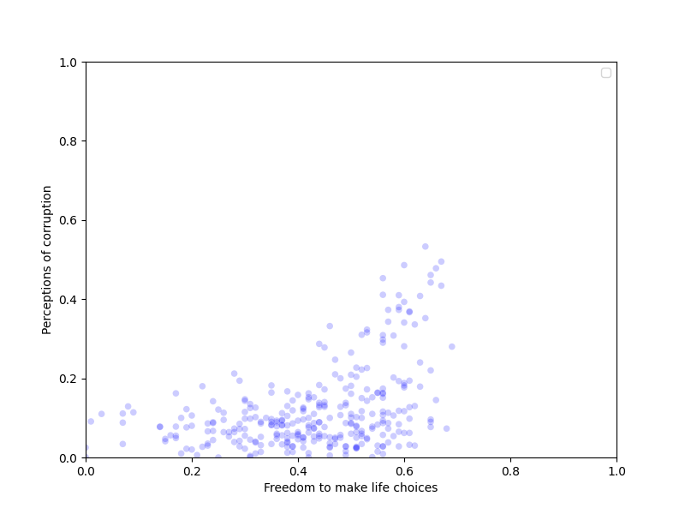
Pearson’s Correlation
This scatter allows us to see the strength of the association of the variables and we can notice the slight correlation relationship between the variables.
The low correlation allows us to see these two societal values expressing an overall relative strong trust in government—still, a lower sense of freedom to make life choices.

Slide 11
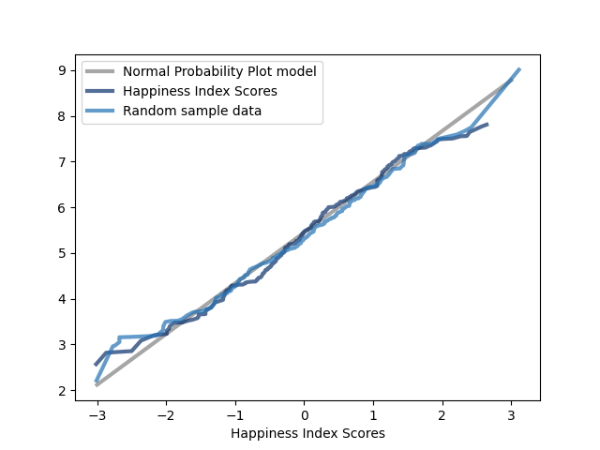
Normal Probability Plot
The straight line on the plot reveals a normal probability for the Normal Probability plot result of this distribution with values in the tails deviating more than the values near the mean.
Showing the results for all happiness index values, and all other variables from data table.
Both curves match the model near the mean and deviate in the tails.

Slide 12
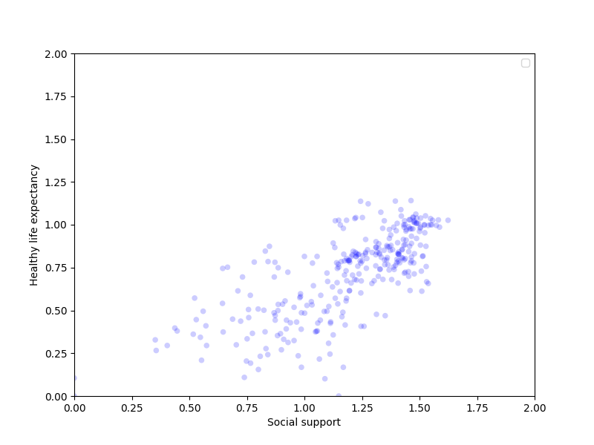
Healthy Life Expectancy vs Social Support
Based on the plot, it is observed that a positive correlation between Healthy Life Expectancy and Social Support is showing.
This indicates that as Healthy Life Expectancy increases, Social Support also increases.

Slide 13
Perceptions Of Corruption vs Freedom To Make Choices
The correlation of Perceptions of Corruption and Freedom to make life choices is showing a positive correlation.
This indicates as the perception of decreases, the freedom to make life choices increases.

Slide 14
Summary
I combined two data frames from the happiness index's surveys from 2019 and 2020. I validated that the variables matched-up and removed any incompatible variables, identified the missing values, outliers and unusual distributions.
Missing Values/Outliers
The data set has 12 variables with zero values that could be defined as either outlier, missing values, or errors. Considering it is a minimal amount of missing values, I overlooked this fact in the analysis because I don't consider that will influence the analysis's conclusion.
Variables
Country or region - Geography location
Regional indicator - Continent
Ladder score - Happiness level
Social support - The sense of social support of the individuals
Healthy life expectancy - Life expectancy
Freedom to make life choices - The sense of social freedom to make life choices
Generosity - Generosity
Perceptions of corruption -The perception of corruption of individuals
Source
Kaggle - The Happiness Index
https://www.kaggle.com/mathurinache/world-happiness-report

